Slide 1


K.L.N.College of Engineering
An Autonomous Institution | Accredited by NAAC
(Approved by AICTE, New Delhi & Affiliated to Anna University, Chennai)
Department of Electronics and Communication Engineering
FALL DETECTION USING IFTTT
Presented By
Latikaa Tejus. J (203010)
Lakshmi sri .M.S (203104))

Slide 2
ABSTRACT
This prototype can assist old people in their daily life ,leaving their family stress-free.
By using NODE MCU as the basic board, we connect pulse detector and MPU 6050 (pressure sensor) to collect the data needed.
By using the popular automation software IFTTT this process is much more easier than using a typical GPS module for communication.
If a situation out of order occurs like increase in heart rate or accidental fall this device sends a alert message to the number assigned to that particular device.

Slide 3
INTRODUCTION
As days proceed older people are interested in living independently and they wish to live in their own.
Falls are one of the leading causes of injury and injury-related among older
adults.
Approximately 30% of adults over 65 years of age fall each year.
This device is designed to mainly help old people or even people with Alzheimer’s.

Slide 4
OBJECTIVE
This system focuses mainly on the issues faced by older people.
Our project aims to impact the lives of all elders and even people with Alzheimer’s, helping them to cross their, daily life's obstacles independently.
The idea is to provide a watch like device for low price, so people from different class are able to purchase this.

Slide 5
EXISTING METHOD
There are a lot of heath bands available , but only few are equipped with fall detection.
Apple watch SE
Apple watch series 7
Samsung Galaxy watch 4 classic
Samsung Galaxy watch 4
But these bands are expensive and not a lot of people are able to buy this..

Slide 6
PROPOSED IDEA
To build a Node MCU based smart watch that detects “falling", and also generates the pulses, and stores the data ,it is also easier to access and the data generated.
Using the IFTTT software we can send alert to the caregiver’s device in case of any emergency
Specifications
Simple
Economical

Slide 7
LITERATURE SURVEY
Base Paper Title | Year of Publication | Authors
Research of Fall Detection and Fall Prevention Technologies: A Systematic Review | 2019 | Lingmei Ren And Yanjun Peng
Elderly Fall Detection Systems: A Literature Survey | 2020 | Xueyi Wang Joshua Ellul
Online Fall Detection Using Wrist Devices | Jan/2023 | Joao Marques and Plino Moreno

Slide 8
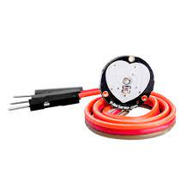
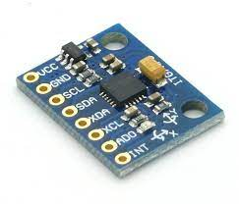
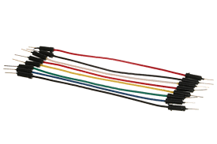
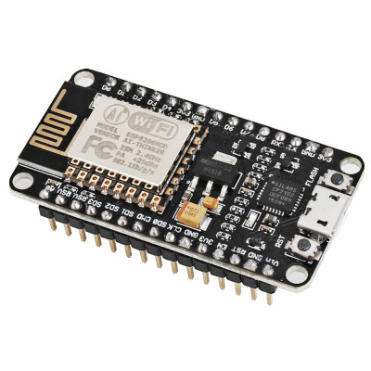
EQUIPMENT USED
Mpu6050 accelerometer
Pulse sensor
Jumper cables
Node MCU

Slide 9



SOFTWARE USED
IFTTT

Slide 10
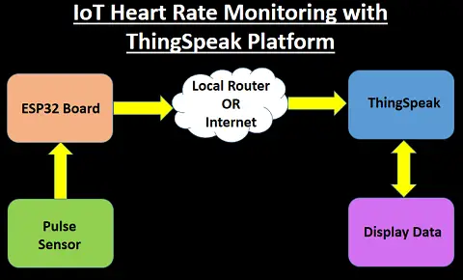
BLOCK DIGAGRAM
Simple representation of how a Pulse sensor works…
ESP8266

Slide 11
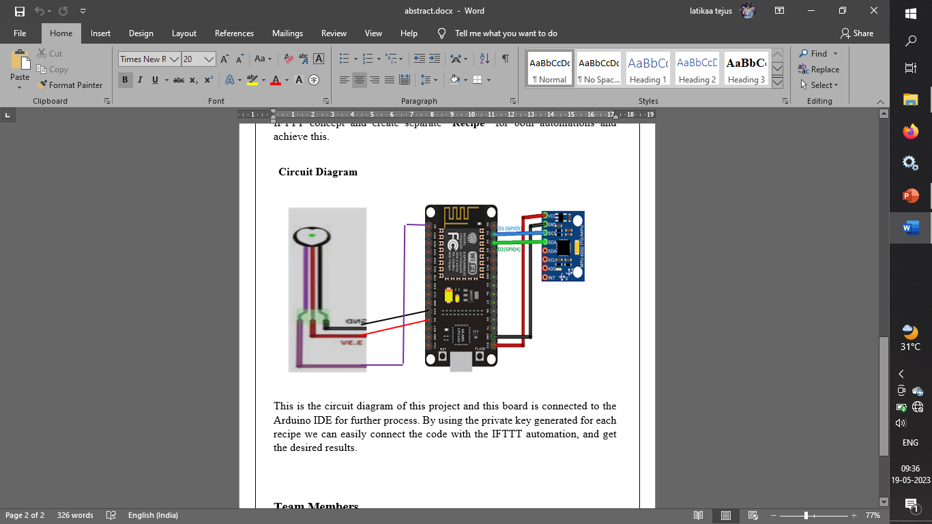
VISUAL REPRESENTATION OF THIS PROTOTYPE

Slide 12
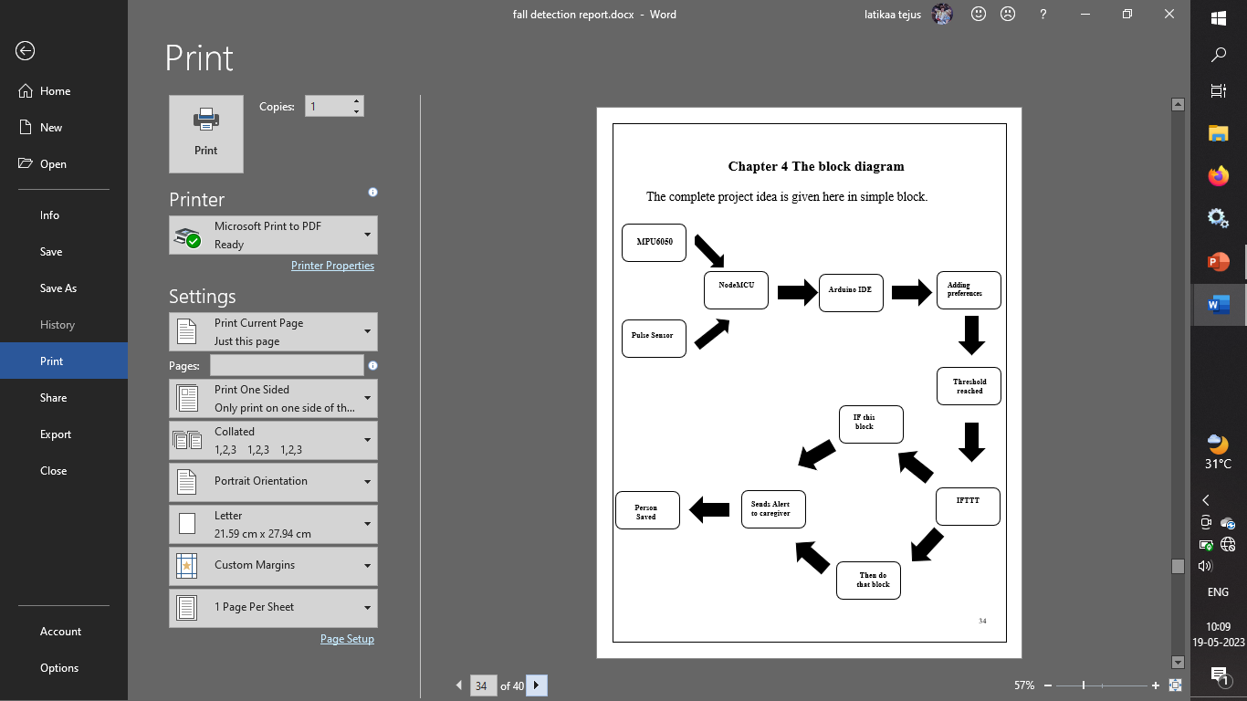

Slide 13
BILL OF MATERIALS
s.no | Materials | Price in Rs/-
1. | Node MCU + (USB) | 300+100
2. | MPU 6050 Accelerometer | 250
3. | Pulse detector | 280
7. | Jumper wires | 30
Total Amount Rs 960/-

Slide 14
OUTCOME
The outcome of this project is to help the elderly people, or people with Alzheimer’s to live their life independently and keeping their family stress free.
By providing a economical smart watch like device.

Slide 15
WORK SCHEDULE
Zero the review - Selection of the topic selection of the base paper
First review - Identify the proper components and purchase
Section Review - Executing the project design
Third review - Rectify problems and improvise in the project

Slide 16
References
https://www.iosrjournals.org/iosr-jce/papers/Conf.17015-2017/Volume-2/9.%2041-46.pdf
https://ieeexplore.ieee.org/document/9360751
https://ieeexplore.ieee.org/abstract/document/7907206

Slide 17
…Thank You…

